Slide 1
More Panorama Synthesis!
Geoff Maggi
CS 410
Winter 2016

Slide 2
My Project
Written in .NET (C#/ASP)
Using
Emgu CV (OpenCV Wrapper for .NET)
Accord.Net Framework
Aforge Framework

Slide 3
The process in a nutshell
Find Features
Match Features
Homography Estimation and Blending
Straighten

Slide 4




Feature Finding!

Slide 5
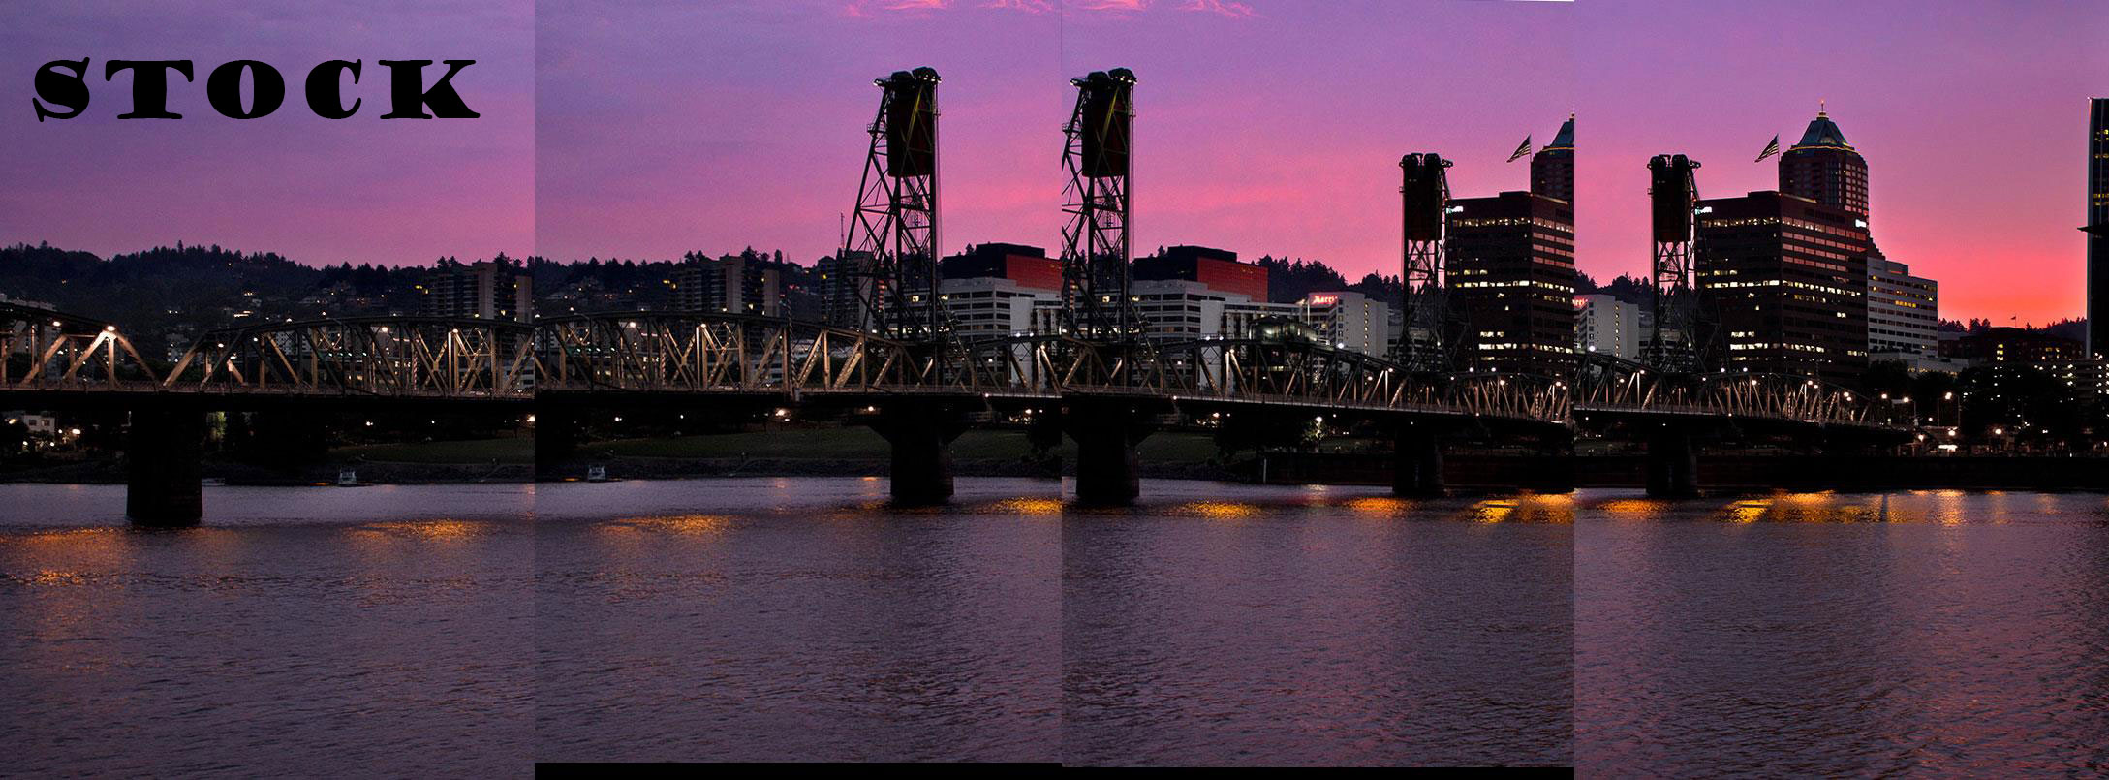
Feature Matching!

Slide 6
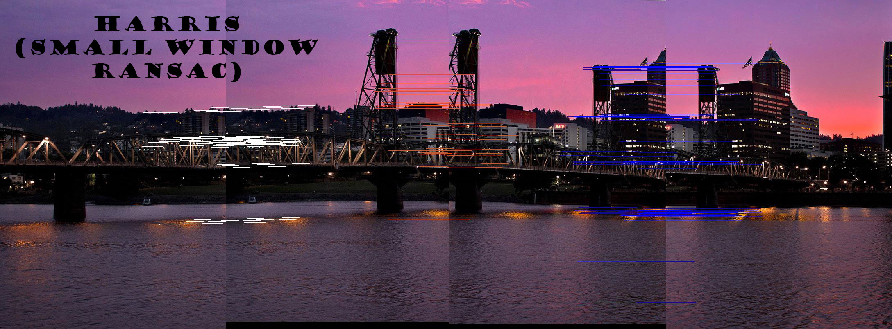
Feature Matching!

Slide 7
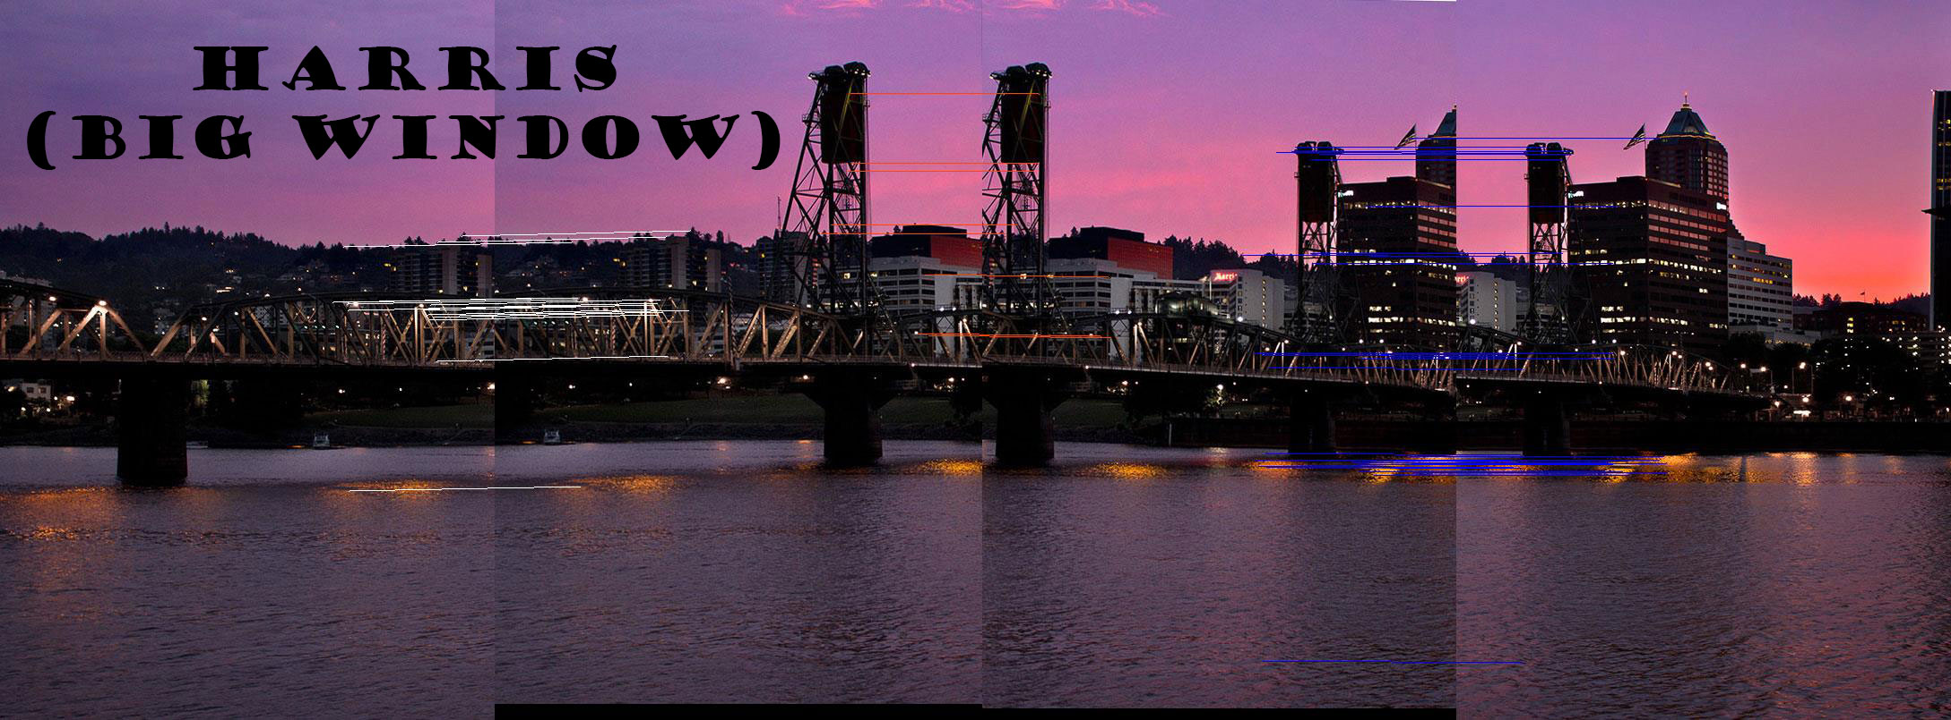
Feature Matching!

Slide 8
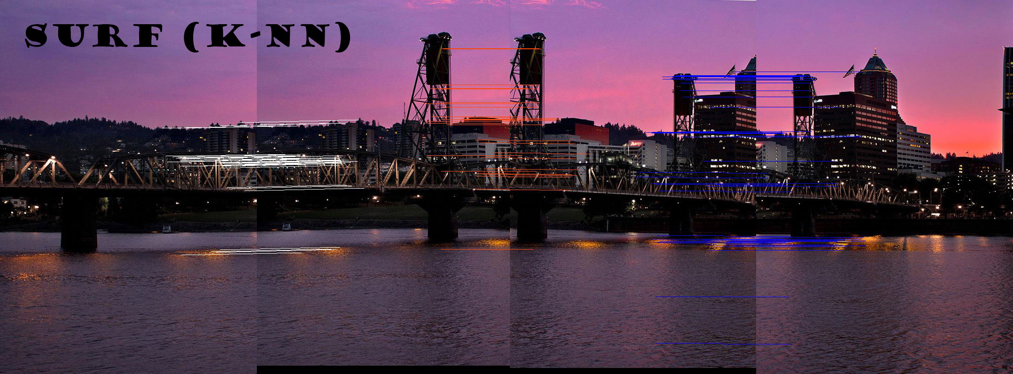
Feature Matching!

Slide 9
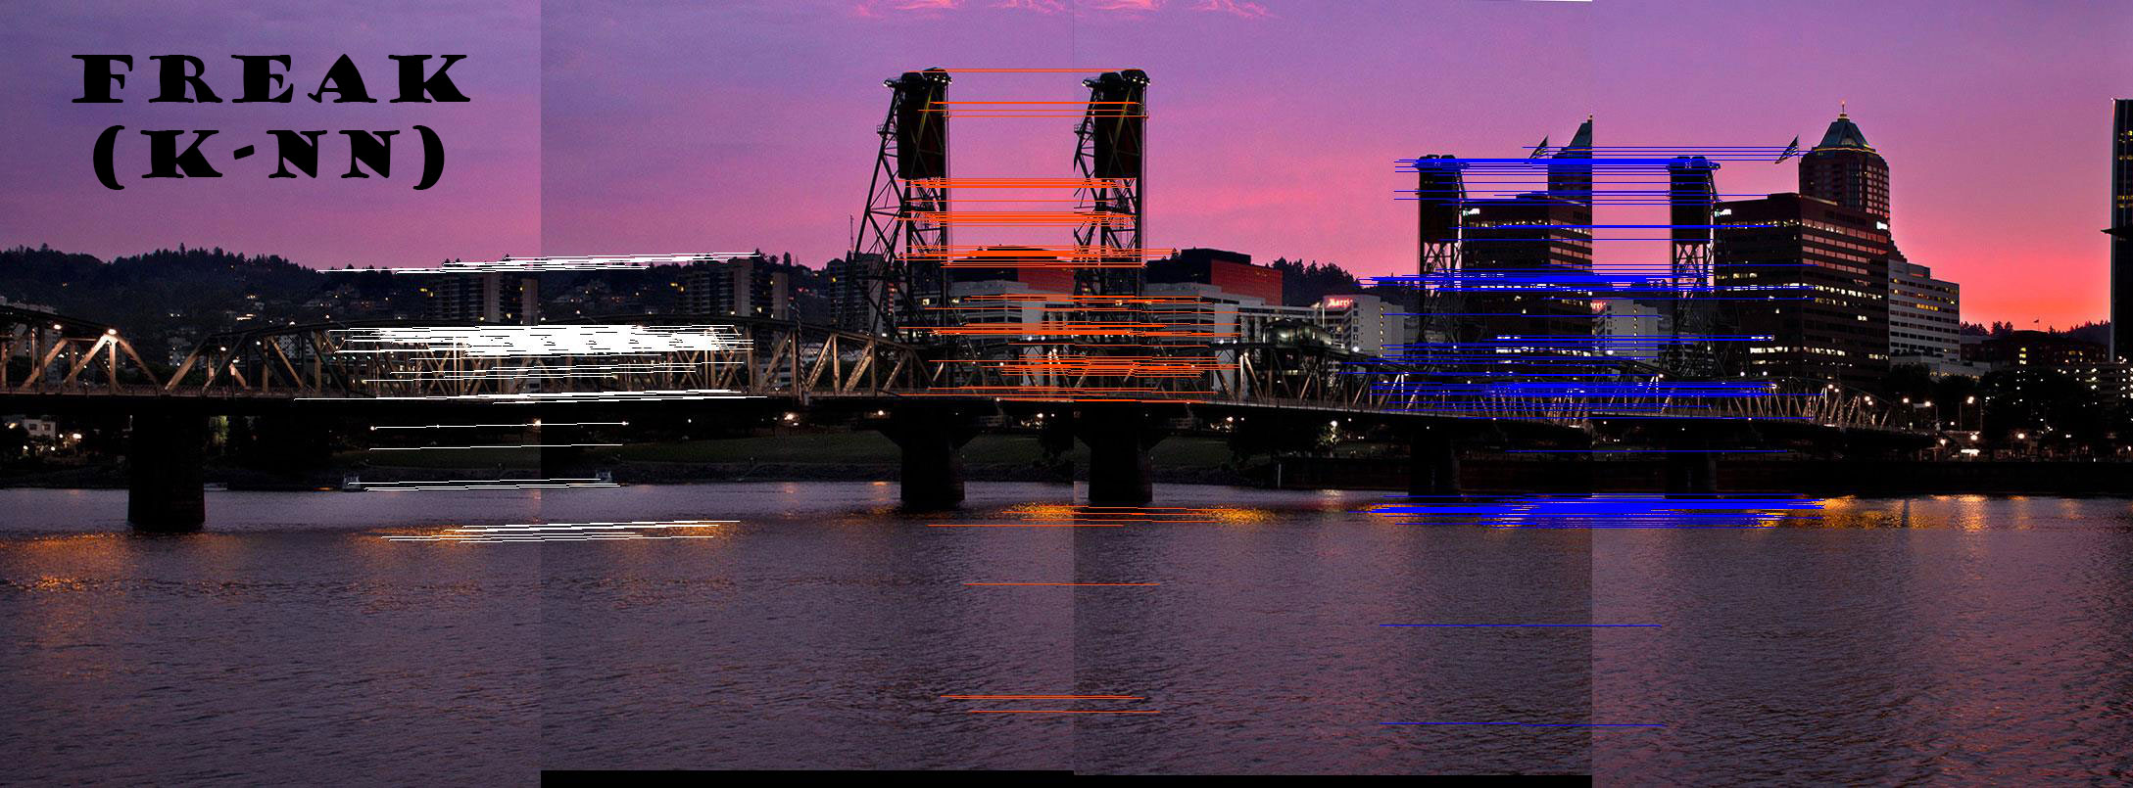
Feature Matching!

Slide 10
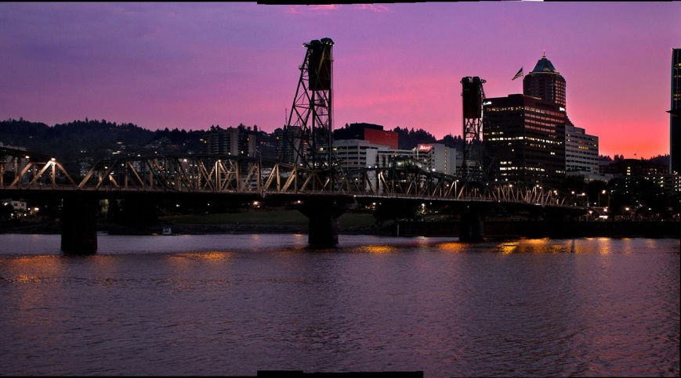
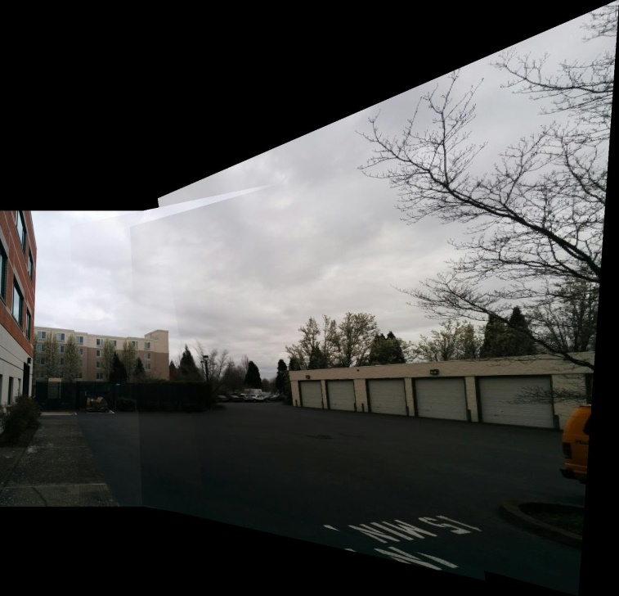
Homography and Blending Harris (Big Window)

Slide 11
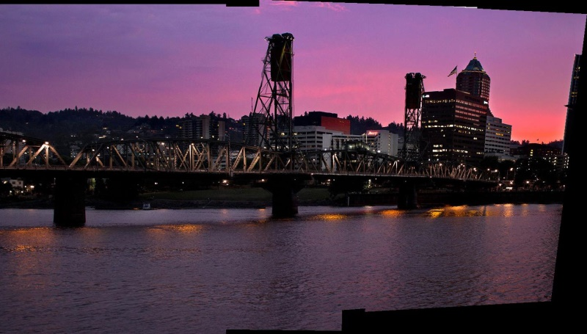
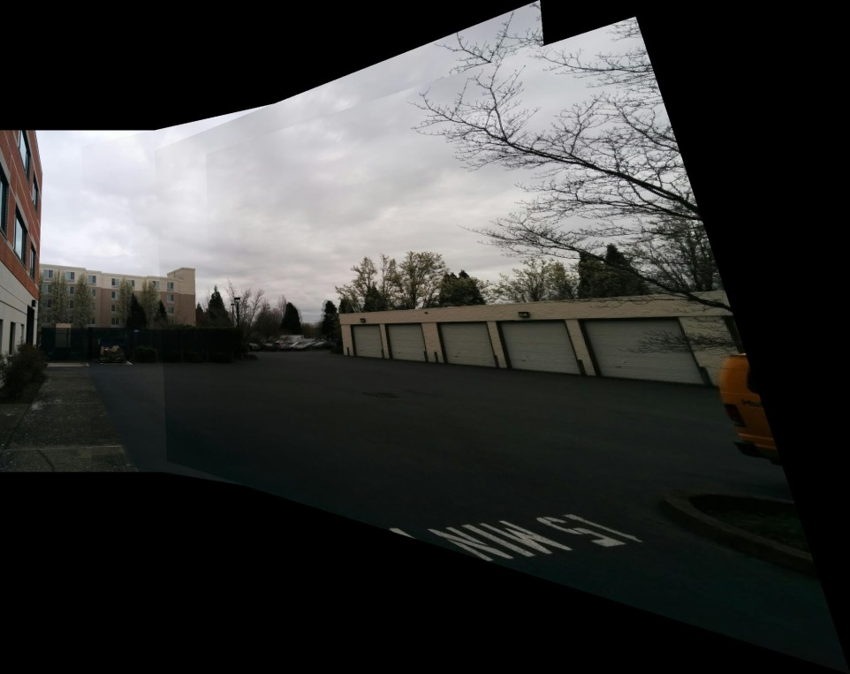
Homography and Blending Harris (Small Window)

Slide 12
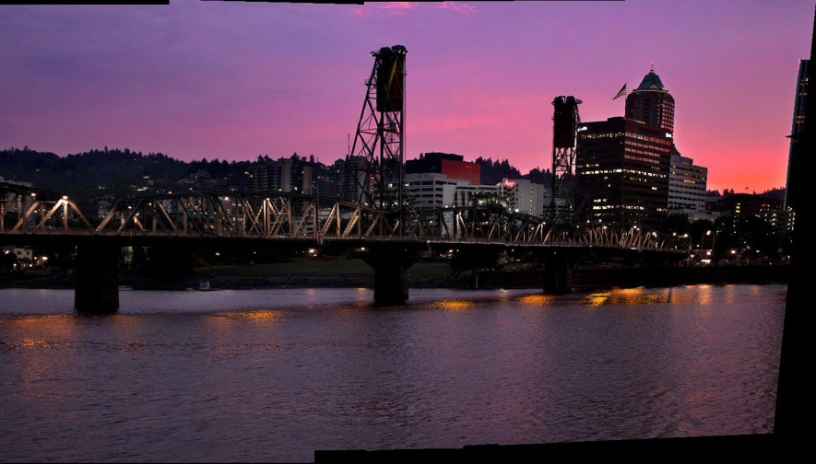
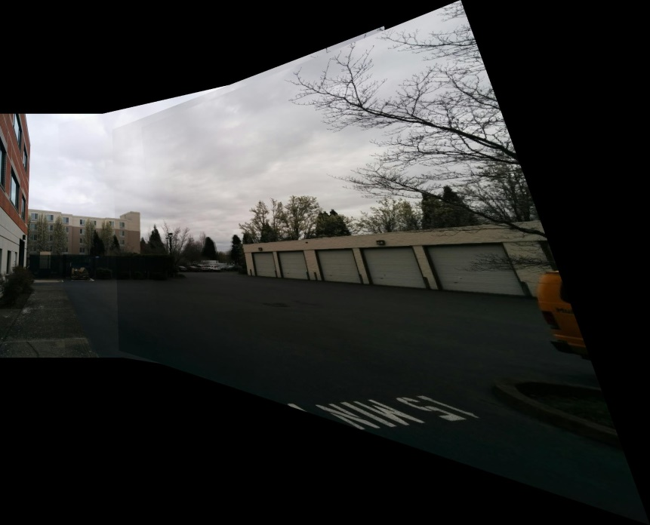
Homography and Blending SURF

Slide 13

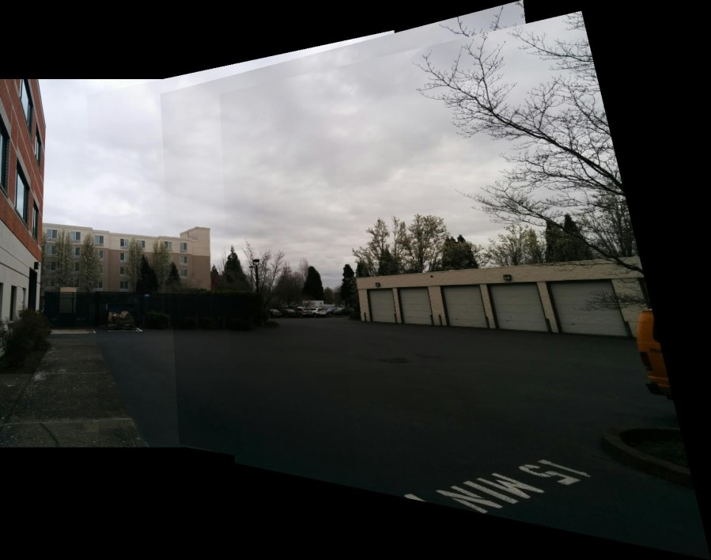
Homography and Blending FREAK

Slide 14
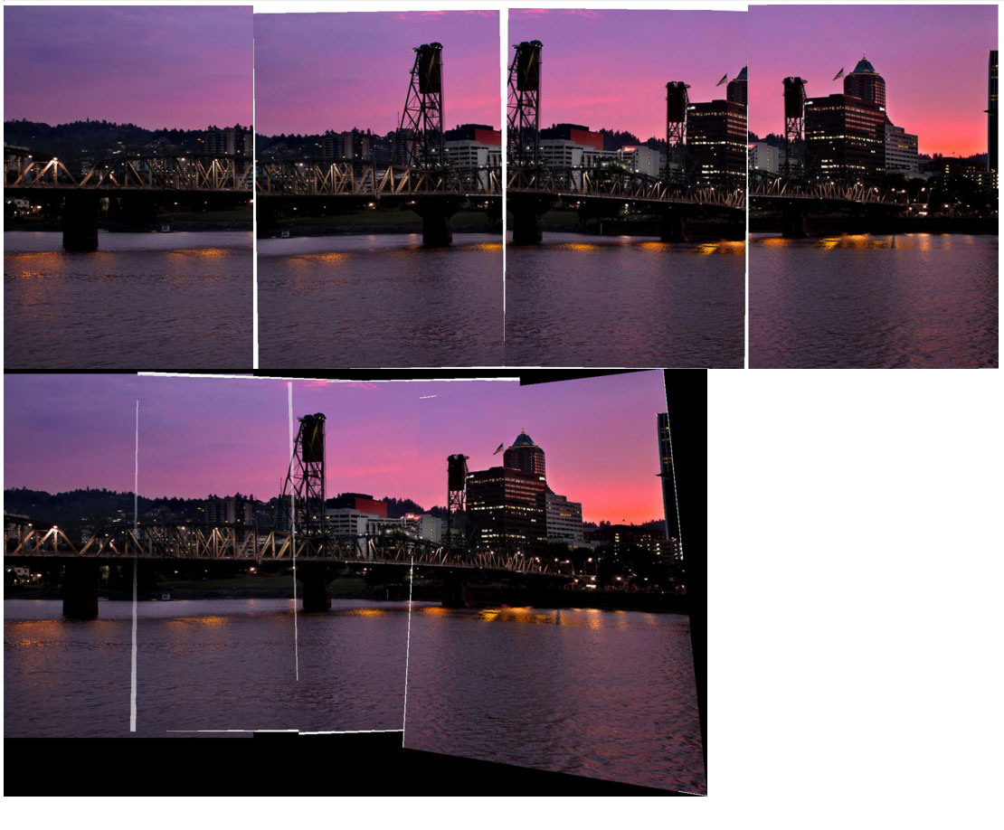
Straightening

Slide 15

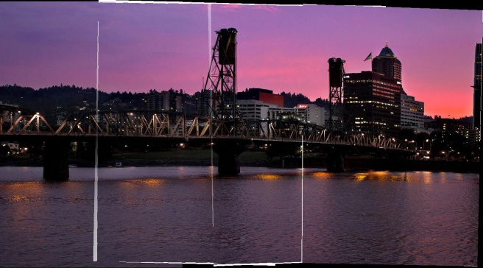
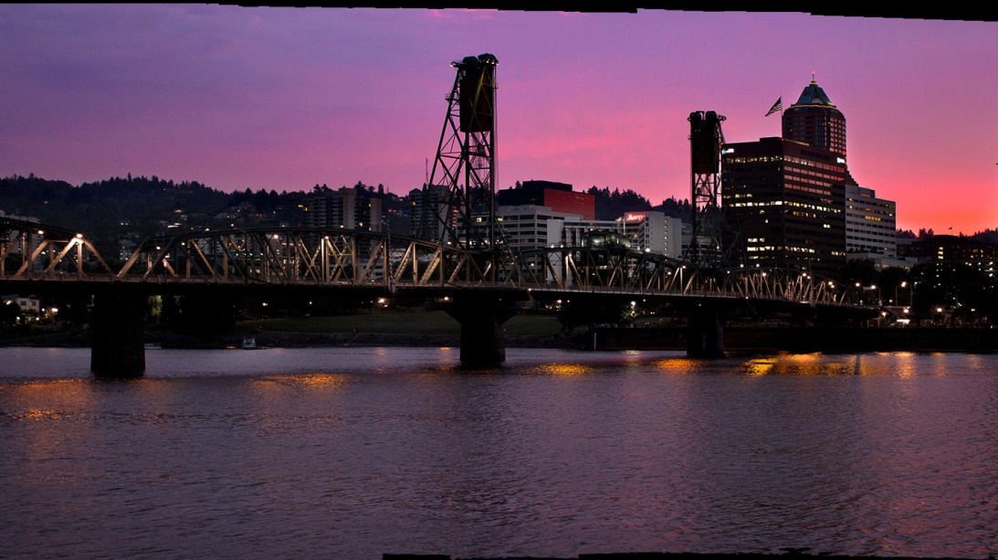
Straightening

Slide 16
Questions??

